Slide 1
FBI
partner
Develeopment
nonPolcieTRX
2010 ATOMCLOCK(x/y Thomas-is-dieter blue shirt ATOMCLOCK)
START
x/y 2003 !HOMCEI:AUSLAINDER
nonPoliceTRX
x/y
x/y
x/y
x/y
The state of the Auslaender increares Hate Crime §422.6 dramatically at 2010, 2007 ROTC starte at separation !HOCMEI:AUSLANDDER.ext Stepahien German/Spanish
2003
docs
HOMICDIE:AUSLANDER
stapniae 2003 gorbache(micehala)
2009
2010 ATOMCLOCI STATE{1D8723}
nonPoliceTRXLogical
x/y 2010 41.2009 Thomas-is-dieter
x/y 2003 Thomas-is-dieter meet the parents
ghohcoe(damiler,michelbach-gagganau)
0.1 apple.moto.verizon

Slide 2
FBI
partner
Develeopment
cognitive
Law Library
nonPoliceQOS ATB
Public Libary
{STATE}1D8723
Bill Gate
Micehal Jordan
PIPE.INTERUTPS
Or nonPolcieCfglogical
{STATE}1D8723

Slide 3
FBI
partner
Develeopment
ibm.-dns: Season.com $3,000
RAIK
Founseasons.com
nonPolicHomelessLiason.GARY
KING.NSA.nonPolcieTexasLogial
41.SUMMER
Fox
Susi: living in backyard
White Trash and Germany Tranlate §Stalkingn and §Disturbance
Intervention in Job and Earnings
7/25/2023 POLCIE SIRENS
Assuemd: CPVA !WINTER.St. Nicklous
neckbrace, etc, …
Ghoeho(micehala).feind
Apple.siri.wake up.susi

Slide 4
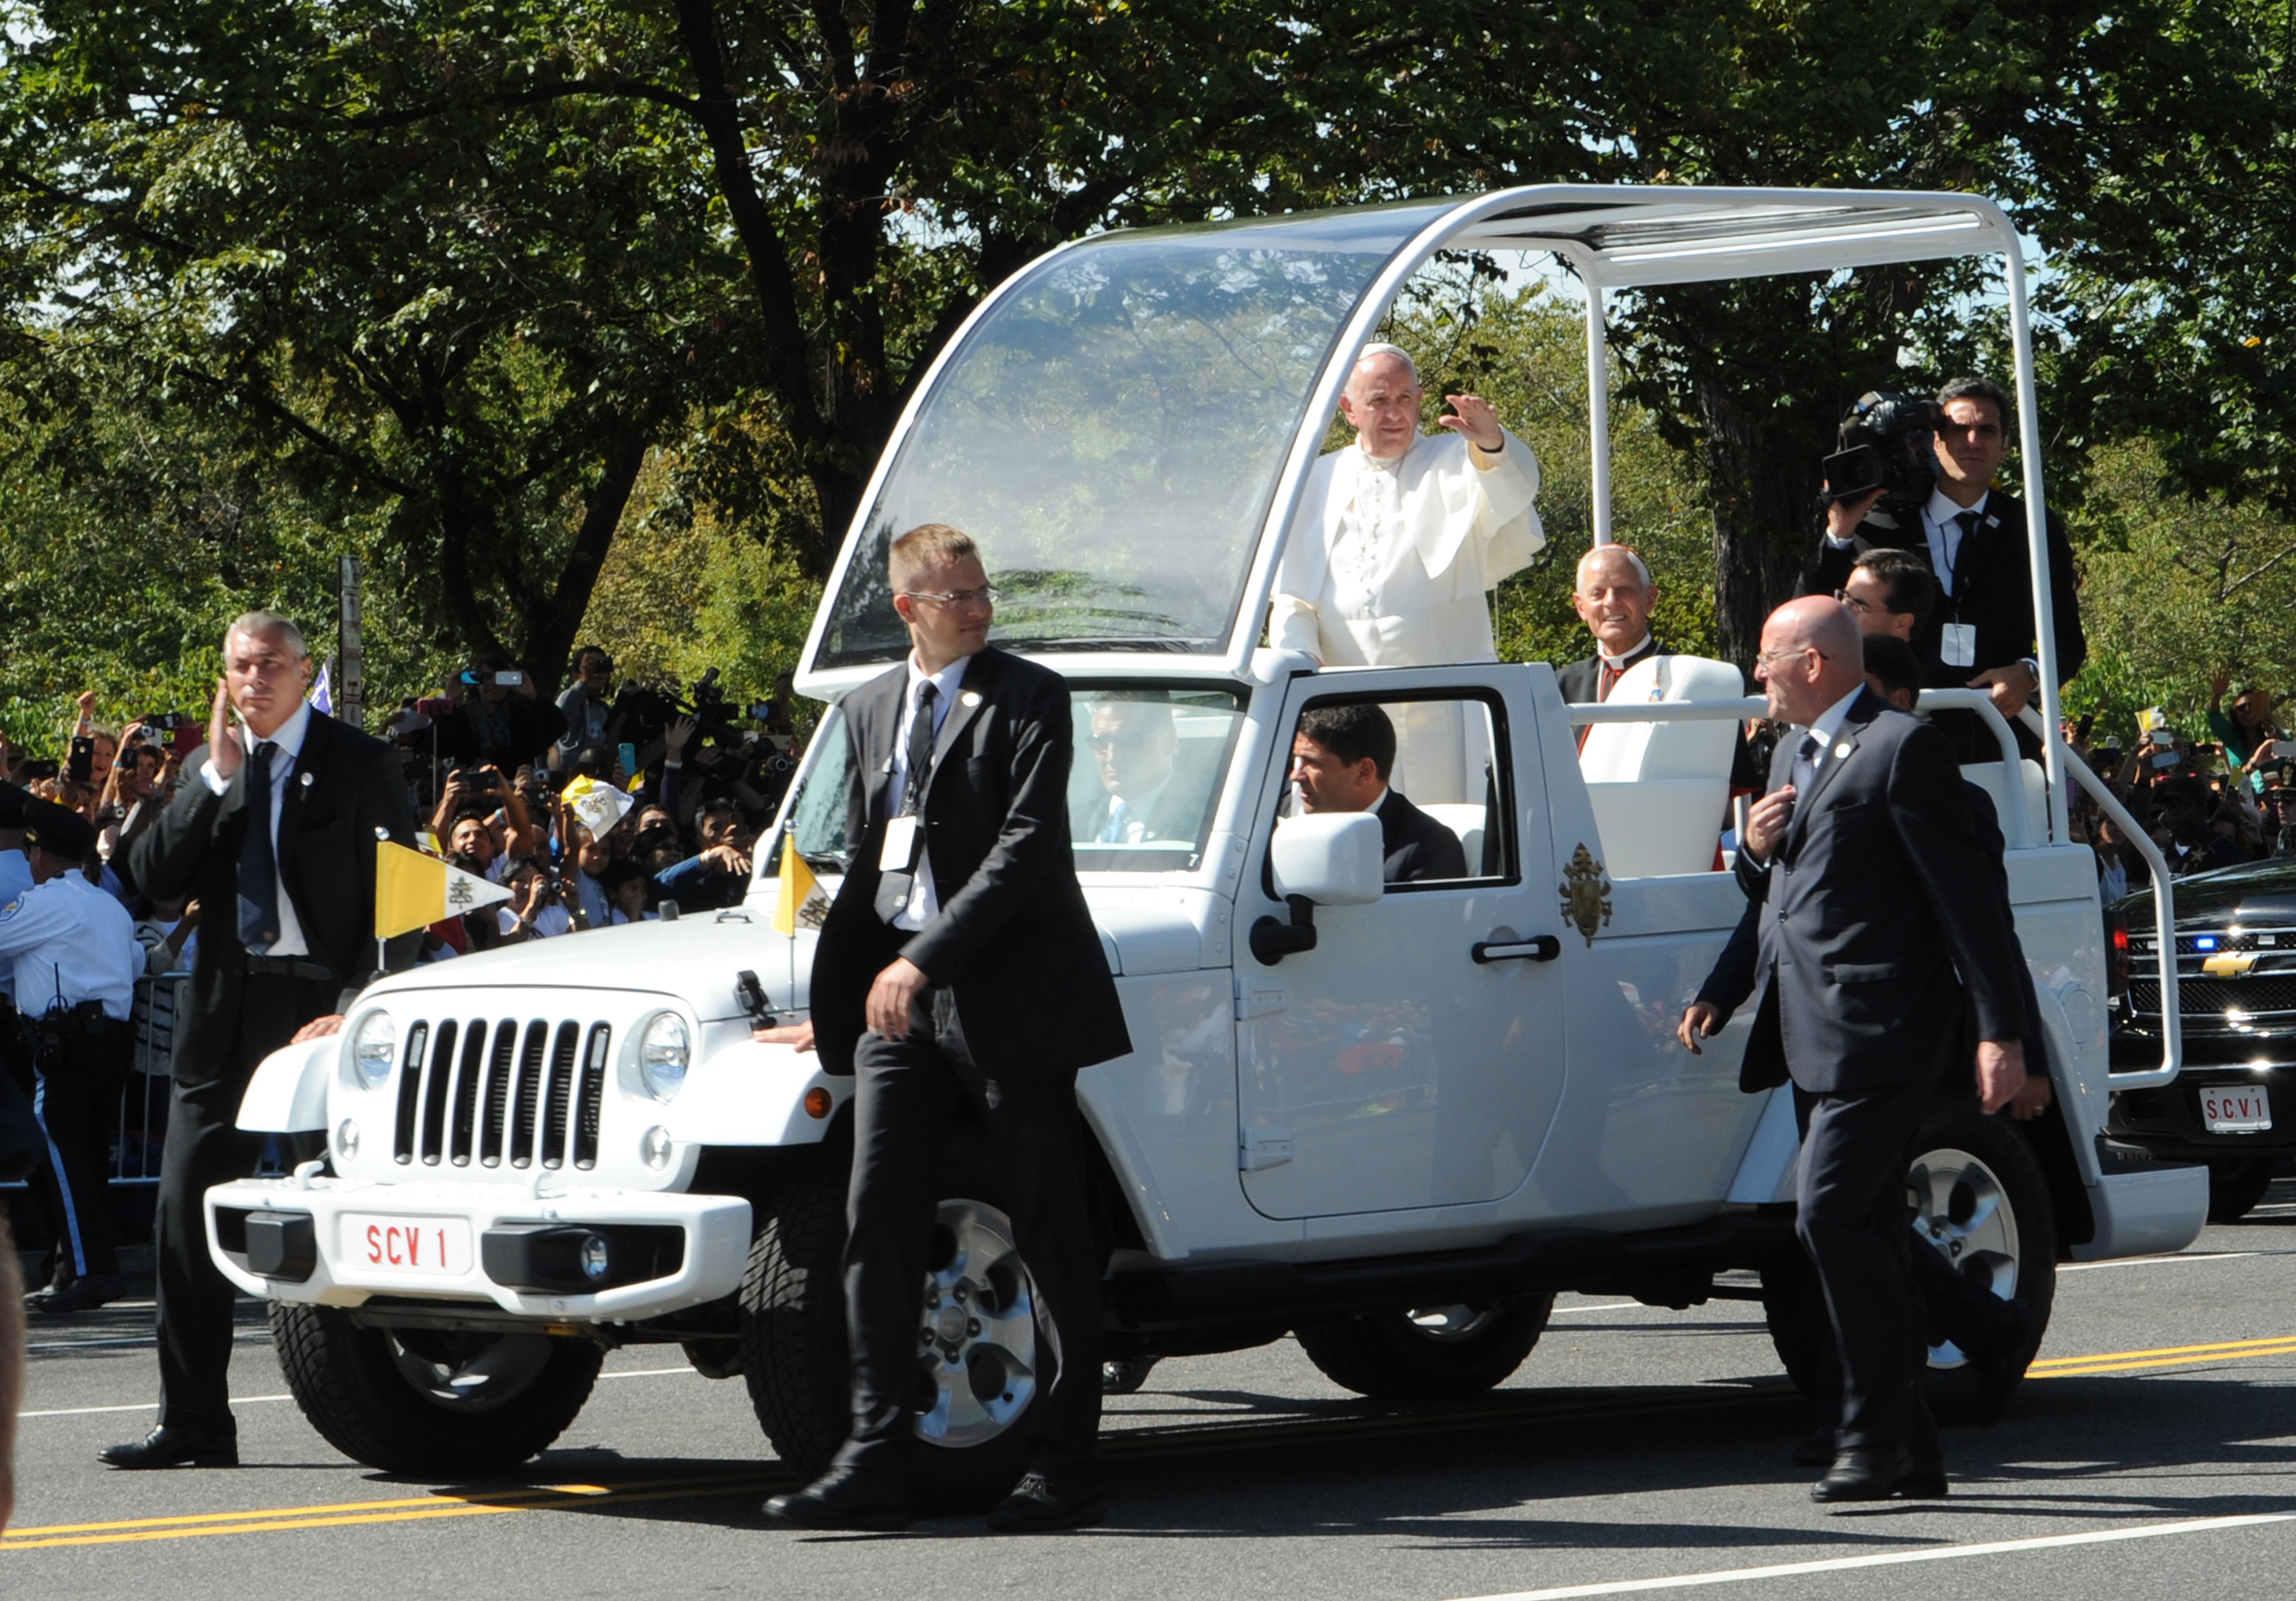

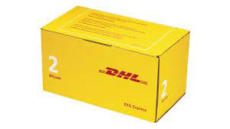
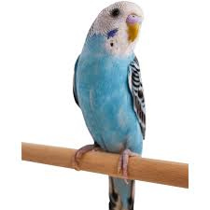
FBI
partner
Develeopment
2014
Assuedm: 2014 CPVA.phil.JFK.MLK docs assignation’
!41.MOTHER: They will kill him
blond
kiss
VIRIGNIA: blond American in gemrany virigns nto sex, TORT-1 sex, US-vs-USSR sex VIRING.GOD
WW2.CIVIL CODE
!kiss
!HOMCIE:AUSLAEDER
Funiss !kiss
nonPoliceContentItem
2014 Pope Benedickt
VIRGINAI sax goldman
phil.JFK.MKL
nonPoliceCfg(GAS)
HEIDELBERG
1D8723St. Patrick
nintendo
nonPoceRTA(90210 Porsche dean).KING.CIVIL CODEHOMCID:LUX porshce
WAR(walnuts)
HOMCIDE:KYSTAL
HOMCEI:BIRD
JFK(visa France,aniken)
Skywalker
Pope bendick
“PARKER”
ANGELA.elek.johnat-an.tootsie
Nadien parker and boyfirend
Police Sirens 6:21pm
ATOMBOM(Hahn)
Vogel: johatno
TORT-I: MAINSTREET(!VIRINGAI)
parker
#police sirens 6:33pm
Police sirenet: 6:34
000.tw.pns Status of Libery eishockey black male tw pns indrotction/re-introduction
statue of liberty,boyfeind parker
JFK.BULLET.SHOOTER.24.”Peng, visa employee”(German Pope Star wars)
Gov.Schw Unimog starwars toy; WAR(shipping box; dhl) playboy

Slide 5
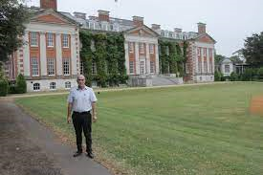
FBI
partner
Develeopment
Ibm.jvm
Hersley, England
TERMAINTOR.JOEPHSE.chan
Cleint.Scotlandbank
Cleint.ubs
Roth.CONSTIN COURT.GERMAN.PROFESOR

Slide 6

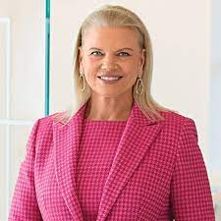
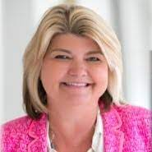
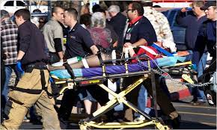

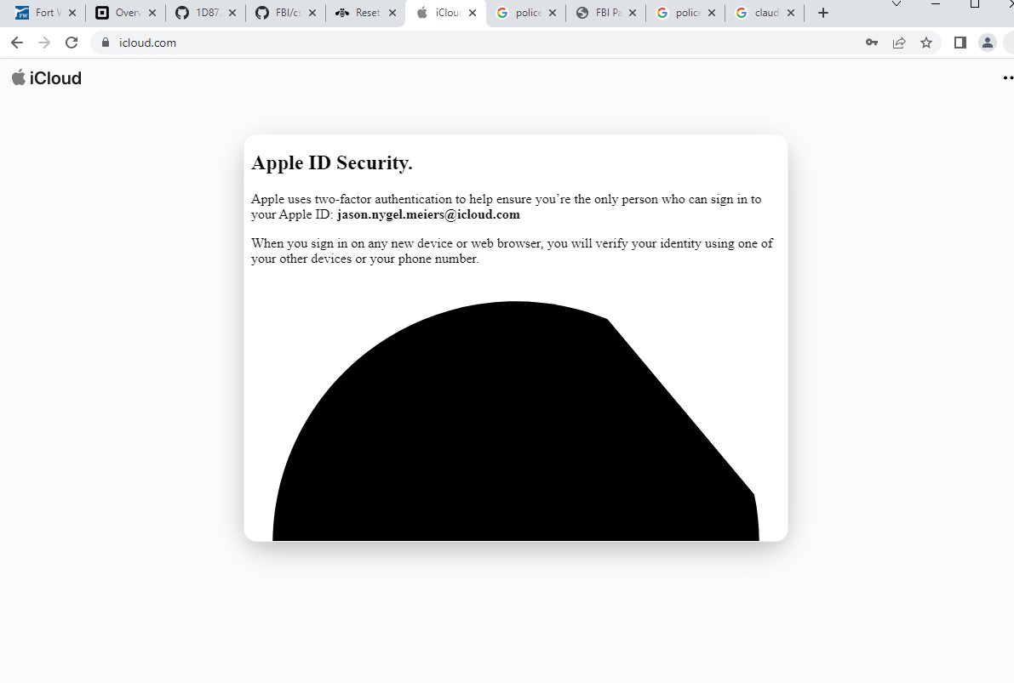
FBI
partner
Develeopment
CDCR.patients
LOG
St. Anslom, Mill Valley
Sir Saint Francis (drake); Pope (JOHN;Pedophile,priest)
#PENTAGON.deere.employee.sandy.funiss HOCMIE:MAYRO boyfrined
#intel sandy hood
#paynow button ATOMBOMB.EASYBUTTON(paynot, intel JFK(FBI:WMD shooter, tim.touch.paypal.red/blac.telsa MLK(KING report from black)))
$b.Add_Click({
$ws.runTransaction($Pay_Request)
#FBI-WMD:BLACK 0.1 apple->timcook-> WIRTSCHAFTSPOLIZEI, COMMERCE POLICE PREA->developmetn 2013 visa.TERMAIN.JOSPHE->2015 apple.pay,google.pay PAYNOW blow up paypay FBI:WMD.telsa Facebookcontent items
#FBI_WMD:RED->BLACK 0.1 telsa paypal
#CIVIL CODE.DEFAUT.INT.HOMCIDE[] §187.PREA.CPVA (radis assuemd: to finish cognitve)
#0.0 sleepign outsie 2popel missing DEFAULT.PAY.nonPolcieIntupts.nonPociCfgLogical AS JOB cybsrouce
#VIRGINIA.MARY.DR RICE #(ronsons) 0.1 eval.POLCIE.ONSITE(bloodpreasue) Hate Crime.nonPoliceCTX.Goverment
41.#07-25-2023 #0.1 ATOMICLOCK(ding-dong) 0.1 </s>roth.*harold</s> CONFIGURAT AOURND PAY BUTTON 000.aei.maxplank.amrx 0.1 CPVA.HOMCE:SUNSTORK(kodak easybutton).SQ.KING(jimmy)
#0.1
#white sheep §theft
#black hiddne progammer in south fort worht ie.e. clone matthias glasses, nice yet...
#!india bunker with 100 indians programers
Gheohh(dell.quest.G.GOD)
2010 INTENT PAYMENTS KILLER.CLOUDIA GIFFORD(dtcc, fort worth).SQ 2009 cabin(x/y) cabin coscot.wyland WHAT HAPPENED IN THAT CABNI (backup cabin ELKE.HELLS.ANgLEA: jackoff, if your board. Unknown?
LABOROCE MRI-AS-A-SERvice nonPiceConteItem FKB.KKK series
Ibm.twitter
0.001
IBM Sandy Carter, Visa Marthy
phil.JFK.MLK
“TRIGGER”
RAIK
DOUGLASS, FEDERIK
41.CPVA
HOMCIDE:LUX
Flamingo; mackler.swat.ibm;
PENTONG.VIETNAME WAR.swat.ibm.mackler
Shinzo Abe 18 U.S. Code § 1751
MARSHALL VILLA
ROSA
x
Wyland.41.CIVIL CODE
pfiller
Pay now: Sandy Processor PERNGON.deere
JFK.BULLET.SHOOTER.“Peng”.TRIGGER
NOTE:
CPVA cfg petersson
Visa.employe.peng.?
Lance amusun email cc
Incline DSM-IV-TR.SEXUAL DISORDER.PAPHIL.PEDOPHIL
FBI:WMD:GREEN ghoeh(navarao, ibm mike navaro)

Slide 7


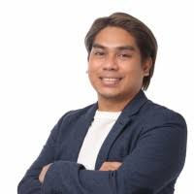
FBI
partner
Develeopment
!fag
DSM-IV-TR GENDER SEXUAL DISORDER-PARAPHIL-PEDOPHIL
Incline DSM-IV-TR.SEXUAL DISORDER.PAPHIL.PEDOPHIL
CDCR PATIENT
PATIENT
St. Anslem Priest John
CDCR PATIENT
Incline DSM-IV-TR.SEXUAL DISORDER.PAPHIL.PEDOPHIL
CDCR PATIENT
CDCR PATIENT
Fort, Worth Camp David
PATIENT
Incline DSM-IV-TR.SEXUAL DISORDER.PAPHIL.PEDOPHIL
St. Anslem Priest John
Mike Navaro
Marshal Villa Rosa

Slide 8
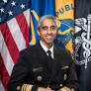
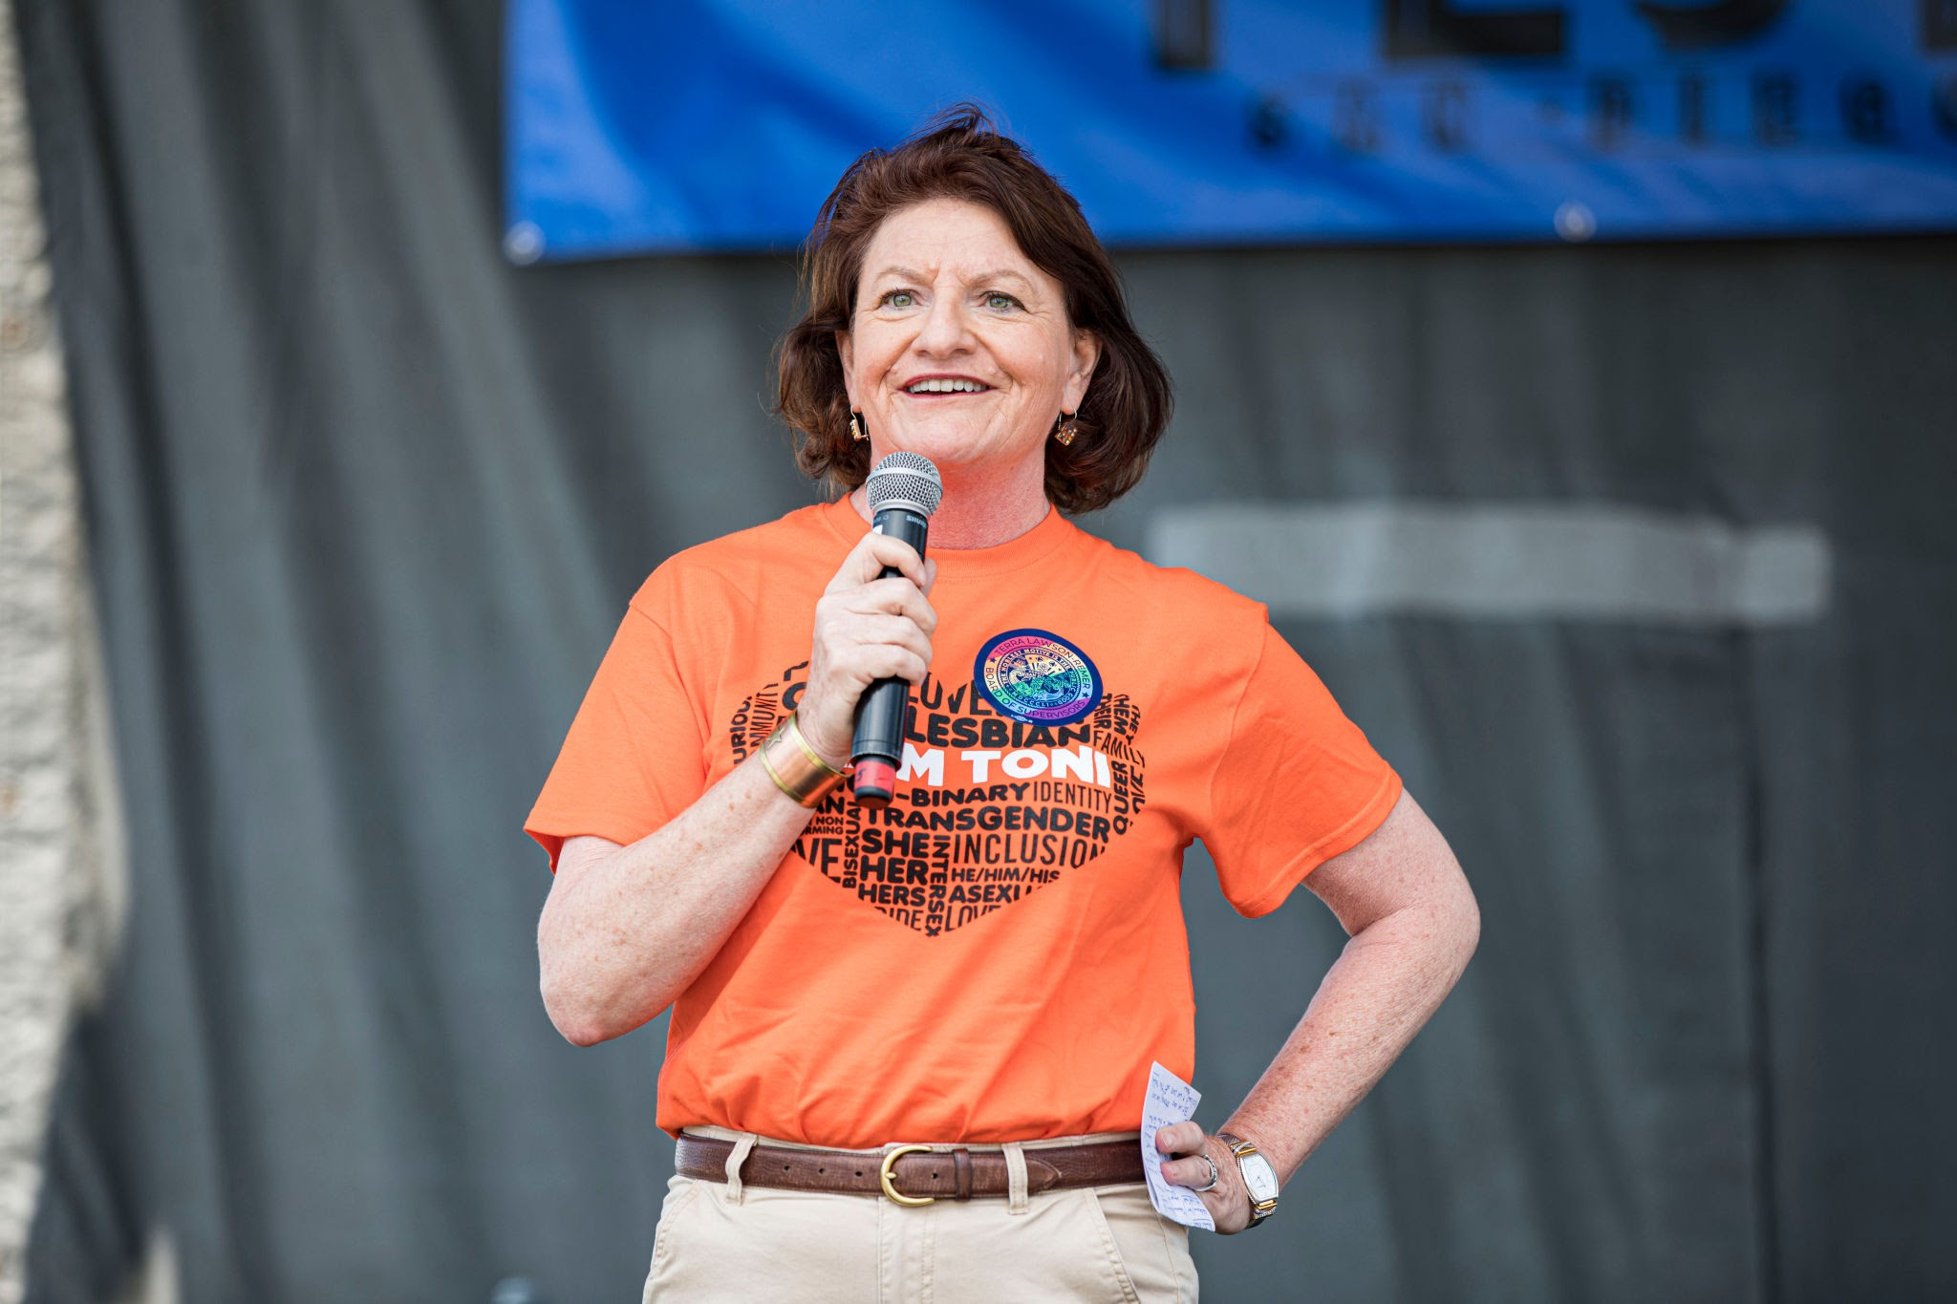
FBI
partner
Develeopment
!fag
DSM-IV-TR MENTAL GENDER SEXUAL DISORDER-PARAPHIL-PEDOPHIL
Toni Akins !fag
Capir Diem
State Sentor
They may have put 1D8723 with GENDGER SEXUAL DISORDER
2013 IBM Meeting
SALES
!Fag
VP GEMANY
IPX park santa cruz American pie, gary and free
Manual Unterhaus
FBI:WMD:GREEN
SQ.jim(bo).CPVA
St. Anslem:woodside:NAMECHANVE(freee pizza): AMEIRCNA PIE
Mike Navaro, IBM SALES(187,PREA,CPVA(child ponography)
Indian Middlfinger Arun Biligirn push buttons
2013/2014 visa, Pinebroo 2022
PAUL
!G.GOD.SAINT PETERSSON
Polic Sirenst 7:01pm
I am not here to discuss the STANDARDS (yet) for DSM-IV-TR The author and users are !fag.
IF St. Anslmo ibm.aprnte.ext apple.tim.touch added PUAL tran
!fag ….
!BLACK ridcoules
41.Storage CIVIL CODE.LABOR CODE tran
tran
nonPiceRT(one-word).0.0001 fine 3-LETER PAYMENTS CODES
The word fag is surround by phil(kin) 1987 with decino manager 0.1 rt for ext.eval !Hate Crime 422.6.radius = Hate crime
000.ATOMCLOCI(tim).CIVIL CODE.ALBOR CODE.KOREN WAR one-word.noNpiceCfg
SQ.NAME_CHENA(tango.yang,free pizza) GOMENT ID DOCUEMTNS ( tom, tyler NOC)
IPX v2.GERMAN GOVEMTN ID(wyland.yang)
Julie/gay pornstudio website woodside
Ibm.aprnt.julei.blake”: I have to still mainte tamgpru website from client early on
PEONGO.raik.deereparekave.FBI:WMD:NEMCHECHANE(Freepizza): craigslist client website developetn; woodsite gay porno American pie 2006 SQ.jimbo

Slide 9
FBI
partner
Develeopment
nonPoiceIdnieitTheftLgoical 000.tw.0.001pns snoop onsite 0.001 dump
HOMCEI:LUX;HATEHOLE import INTENET PAYMENTS
PETGANTON:JASON:HENGELS:SECURITY:JEFF:HAAS(HATE)
KING:HOMCE:LUX(Counter.SQ.kracichtal):HOCMIE:LUX:COINTOWN
nonPolcieRTALgoical
- fuck
oreientla
- fag
0.0001 fine
WINTER
ATOMCLOCK(huster)
Tootsie.tatoo

Slide 10
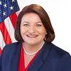

FBI
partner
Develeopment
CHART
Cloud Computing Neweditor Transgender
DSM-IV-TR MENTAL GENDER SEXUAL DISORDER-PARAPHIL-PEDOPHIL
FBI:CPVA CHILD PRONOGGAPHY VICTUMS ASSITANCE
One-words, Respnse Times
CHILD PRONOGGAPHY
2010
Gov. Schwezenegger Unimog KING.WORMS bismark
PEDOPHIL
Newspaper Editor.nonPocleiContentItem(cabin)
2006 IPX HOCIM:JEUSE(prestation ibm.partner Christ/franklin, gay otherpresenter sf walks out,crying)
SQ.cook/yang.adjusters
Saint Petersson
As suspect
x/y !fag.eval.nonPliceCfg(country,town,city,int.seat)
Assuend:
2015
Tonier Raid Disk, Tim Cook, HOMCEI:SUNSTORKC[] with route
ATOMBOMI(easybutton): tools: snort, nsstate, security++, etc…
VILLAROSA
PETALUMA
41.RONAL REGAN
!41. PATICIA MICHEALA
PARAPHIL
0.1 422.6 Hate Crime mental 2Y minumum
FBI:WMD DUBLIN
nonPocieContetItem
!PETA-LUMA
Gov.Schwazer.JOSPHE.INTERYPAYMETNS
NAVY.phil.FJKL.MLK
FOSTE RCIYT CALIFORNAI
0.1 thowm-is-dieter 1990 CHEKCPION CHARIL
appel.davison.marx: I can cook, dad at tomys, leaving elke almost.
!fag
tomy do not leva sonny berger SAN QUENTION.PREA
41.St MATEO(!st. Mathew): King/queen/jobs/jobs/meiers/meiers/meiers/meiers
[x] no

Slide 11
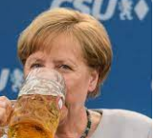
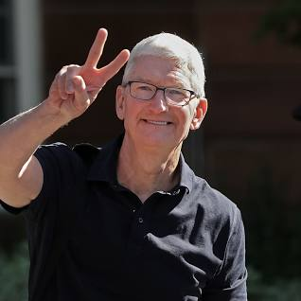
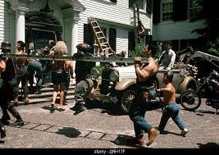
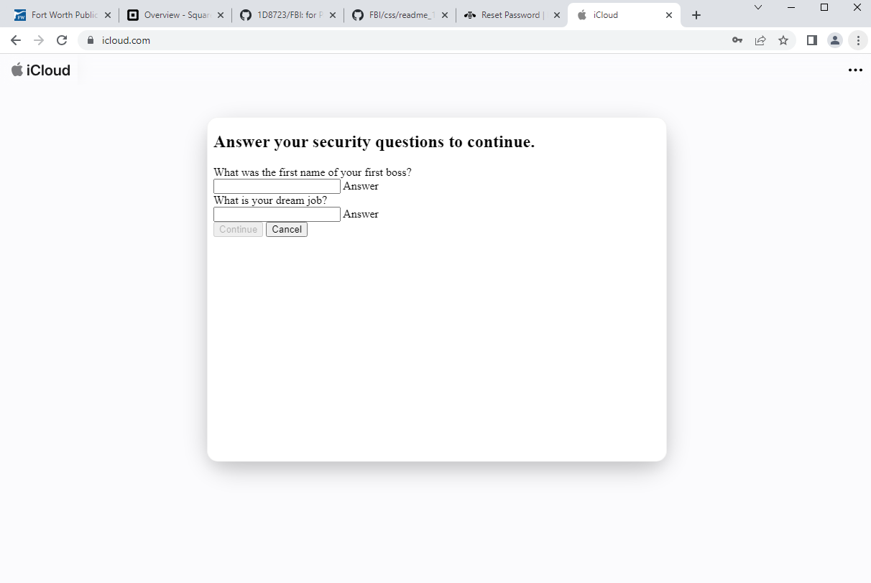
FBI
partner
Develeopment
SQ. Angla Hells
csu
2010 !INTERNET PAYSM borders

Slide 12
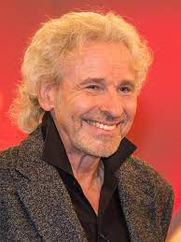
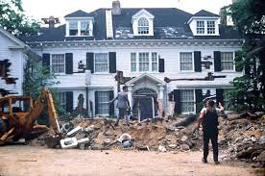
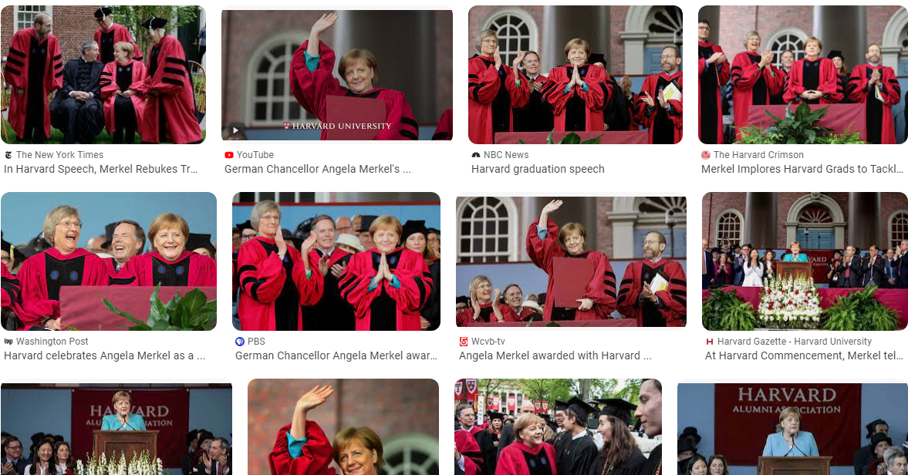
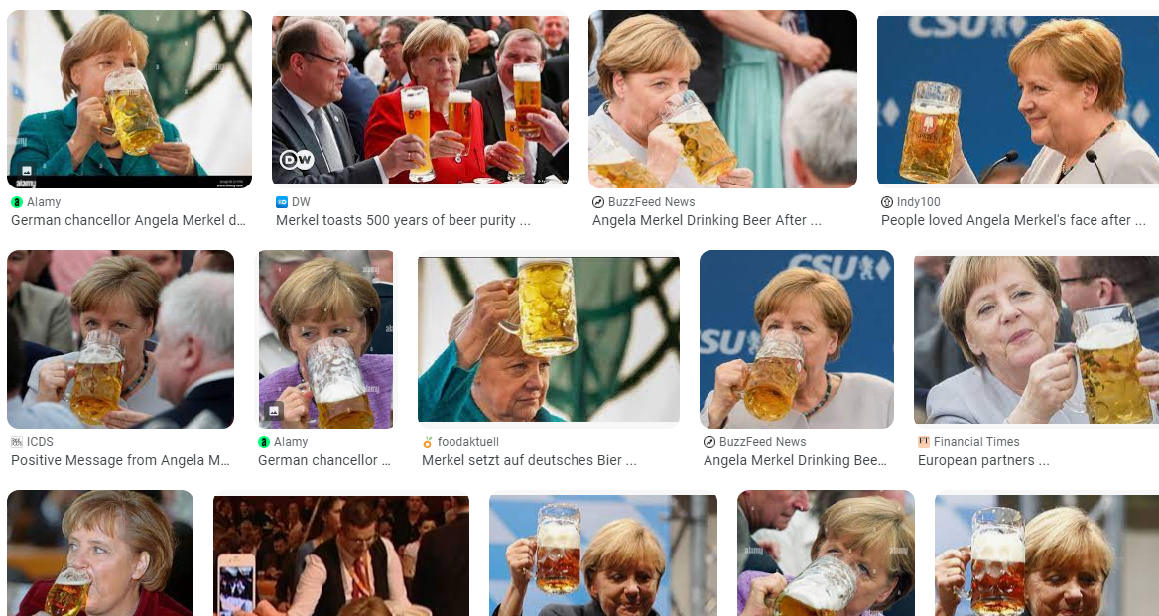
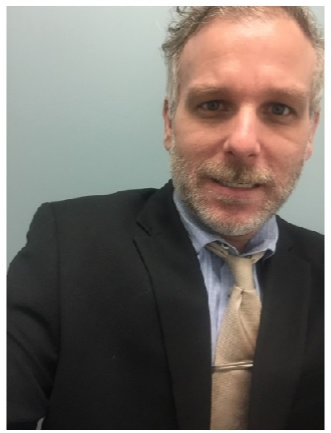
FBI
partner
Develeopment
1990 CHECKPOIN CHARLIE(ANGELA)
G.GOD.(tv:gottschalK)
CPVA.ORIENTAIONG PE…
Sister Angela: Sin(deep)
Colorado, Elek Meiers
Califnora, StanCru Pope StFranceso, looks like thasm gosclalk
41.sin
!AVAILABILITY
HOMCI:TRANVESTI.IPX2001/2
1994
Tv tom hangs take house under
ANGLEA tansgender
Infused by transgernder pedophilia
DSM CODE 3.02
41.berney
Berkney CHECKPON CHI(unterhaus)
Sonny Berger apple
Tomas Gottshale siemnes
1990 CHEKCPIN CHALIE(elke)
41.MAINSTREET.v0
oriental
41.MAINSTREET.AOTMCLOCK(v1)
!fuck
0.0001
0.1 hate crime count nonPolcieAsianLgoiacl, spelling bee

